Slide 1
Baseball Travels
Technology Review
Optimizing distance and cost for visiting baseball stadiums

Slide 2
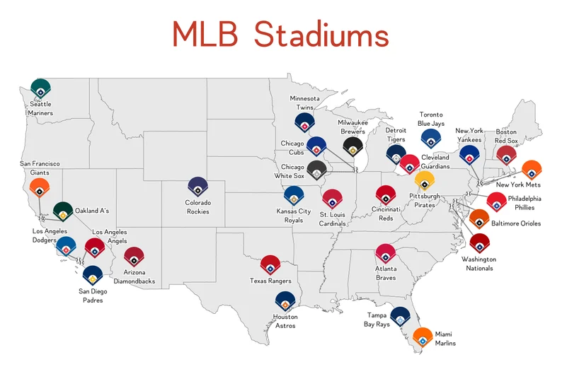
Background & Use Case
Our application is trying to create an optimal schedule for visiting MLB stadiums given the 2024 MLB schedule, given user inputted parameters
Part of the project involves finding an optimal path for up to 30 cities, which can be represented through the Travelling Salesman Problem, which involves finding the shortest route to travel to all nodes on a graph

Slide 3
Python Package Choices
python-tsp
Author: Fillipe Goulart
python-tsp is a Python package for solving typical (symmetric or asymmetric) Traveling Salesperson Problems
https://pypi.org/project/python_tsp/
mlrose
Author: Genevieve Hayes
mlrose is a Python package for applying some of the most common randomized optimization and search algorithms. It includes implementations of randomized optimization algorithms as well as functionality to apply these algorithms to tour optimization problems, such as the Travelling Salesperson problem. It also has the flexibility to solve user-defined optimization problems.
https://pypi.org/project/mlrose/

Slide 4
Package Comparison - python-tsp
Does it address all requirements for the project
The package provides functions that find solutions from distance matrices and also provides a function to create a distance matrix
Ease of use
We anticipate having a filterable distance matrix or a set of coordinates, so the functions should be relatively easy to implement in our code.
Computational Efficiency
Fast computation of distance matrices and solution, tested up to 14 coordinates.
Software Bugs
There do not seem to be any known bugs at the moment, and the author is very active on the github
Availability of relevant examples
The package provides an example of a Hamiltonian path with solutions derived from dynamic programming and a metaheuristic method on a provided distance matrix. It also provides an example of creating the distance matrix if it does not exist.
Open Issues
6 open issues currently on github

Slide 5
Package Comparison - mlrose
Does it address all requirements for the project
The TSPOpt function is able to optimally find the minimum or maximum optimization function value if we define our optimization function and features per location well to the problem.
Ease of use
Easy to use given we have our desired features defined per location and date
Computational Efficiency
Fast computation of optimal path even with 4 coordinates (features) per node
Software Bugs
Because there is one author, there are a few bugs with installation that are common, such as package dependencies having to be manually changed before being able to import it.
Availability of relevant examples
There are a few tutorials in the documentation, one of which is on the traveling salesperson problem which we can follow for our example
Open Issues
14 open issues currently on github

Slide 6
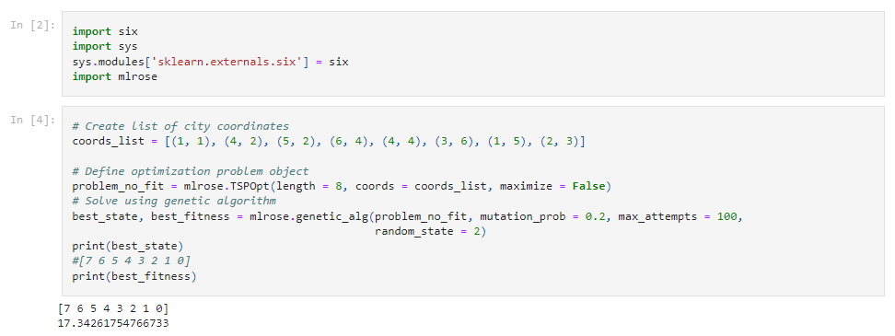
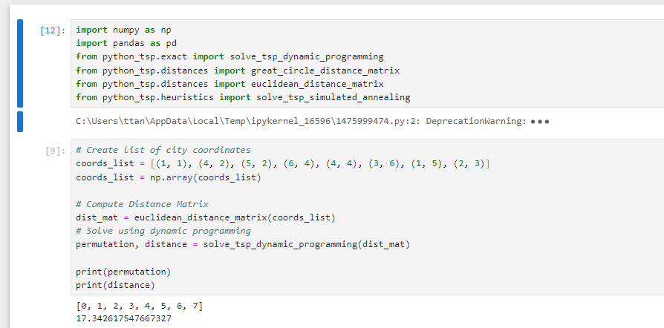
Comparison and Choice
Both python-tsp and mlrose are utilized in similar ways and reached the same solution on our basic test case
python-tsp requires Python 3.9 or newer, while mlrose requires only 3
python-tsp is more focused on the travelling salesman problem, and since it uses a distance matrix, we can use other values as edges on the graph instead of distances or coordinates

Slide 7
Drawbacks/Remaining Concerns
Only the optimal solution is returned with both packages, but we might want to see the top 5 or more solutions in case the optimal is invalid due to other constraints
May not be able to handle scenarios with extremely large number of teams/stadiums
Needs a starting point input
In reality, the nodes within the searchable graph change over time depending on the MLB schedule, so the current optimization problem is simplified to static states.

Slide 8
Demo

